Slide 1
Sprint 3
Music Trivia Web-based Game

Slide 2
Contents
What I did?
What’s next?

Slide 3
What I did?
Add docker to the CI pipeline
Structure backend to microservice
Setup a MySQL database for song service
Do some frontend function for song
Add password hashing
Add authorization and authentication

Slide 4
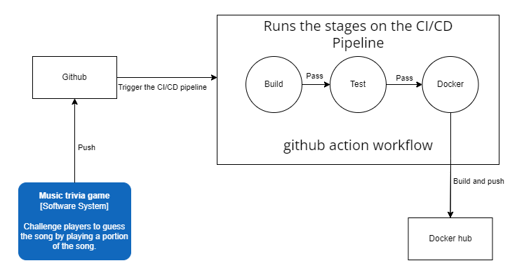
CI pipeline

Slide 5
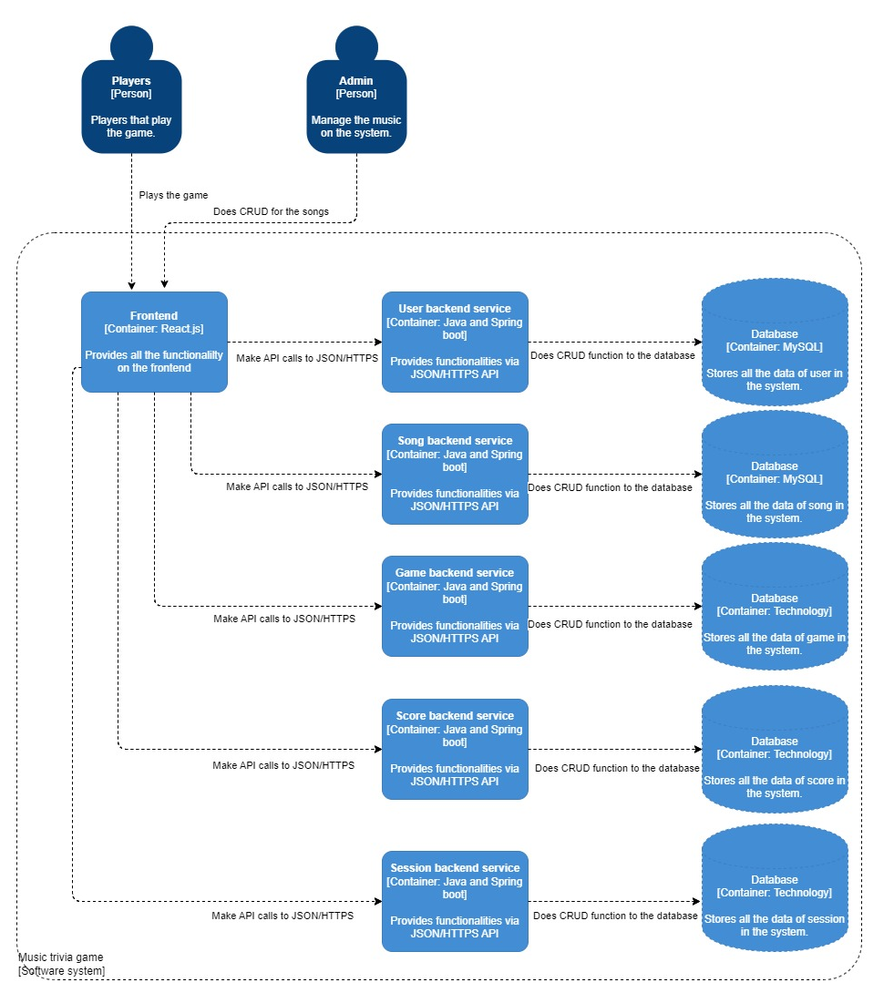
C3 structure

Slide 6
Demo

Slide 7
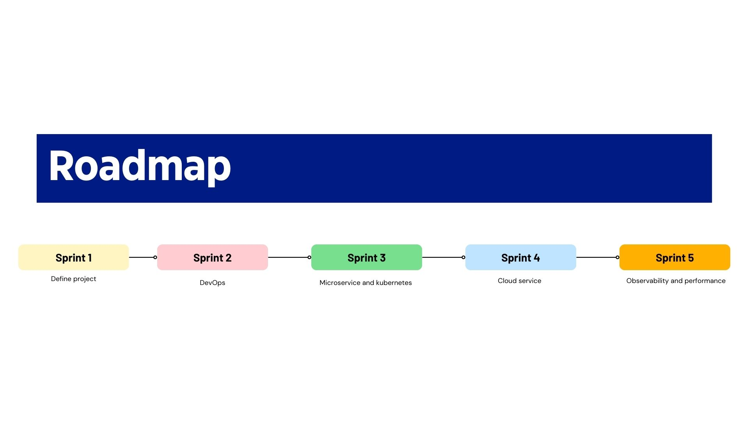
Roadmap

Slide 8
What’s next
Setup Kubernetes
Setup cloud service
Look into and setup CD part of pipeline
Continue with research document

Slide 9

Thank you

